Slide 1
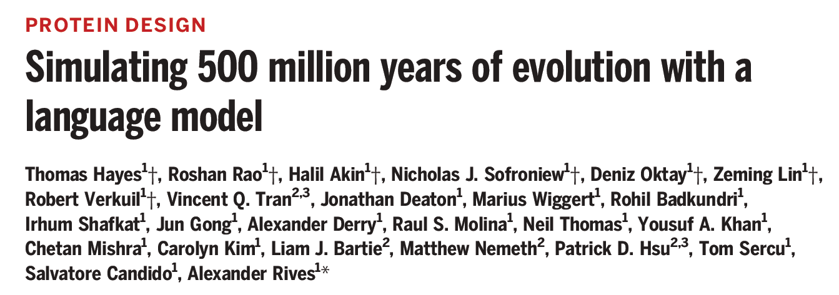
JC 5/2/2025
Wendao

Slide 2
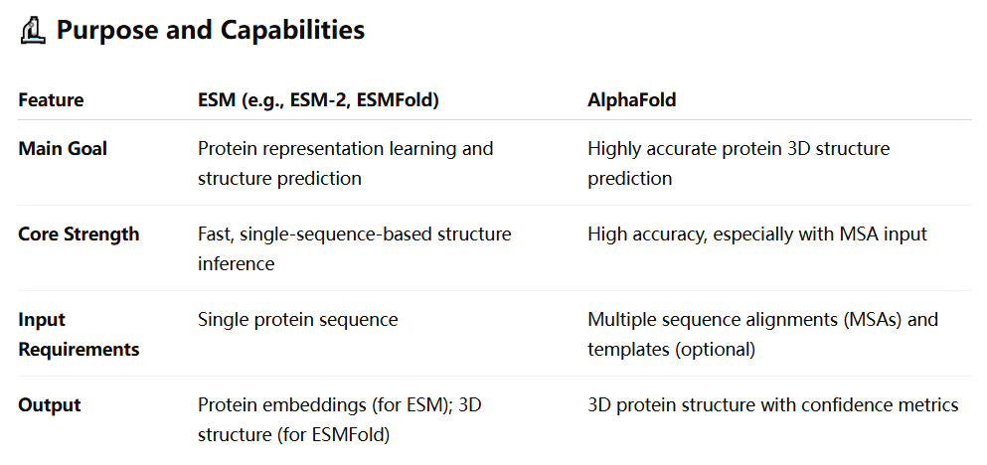
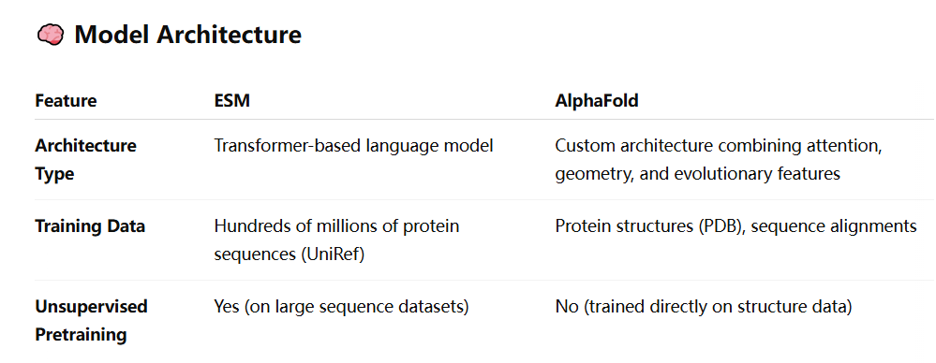
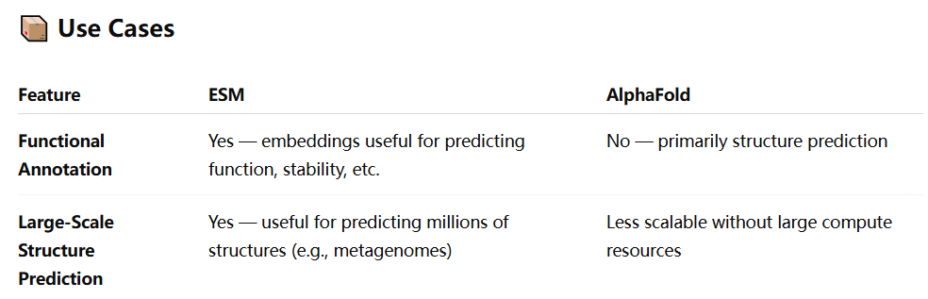
ESM and AlphaFold comparison

Slide 3
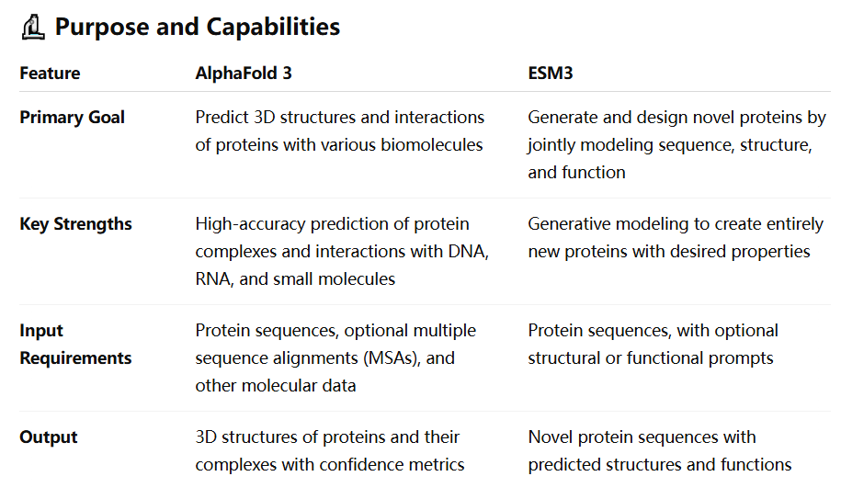
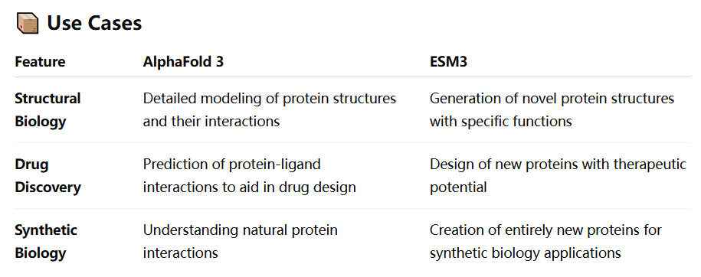
ESM3 and AlphaFold3 comparison
ESM3: generative language model
AlphaFold3: protein-molecule interaction structure

Slide 4
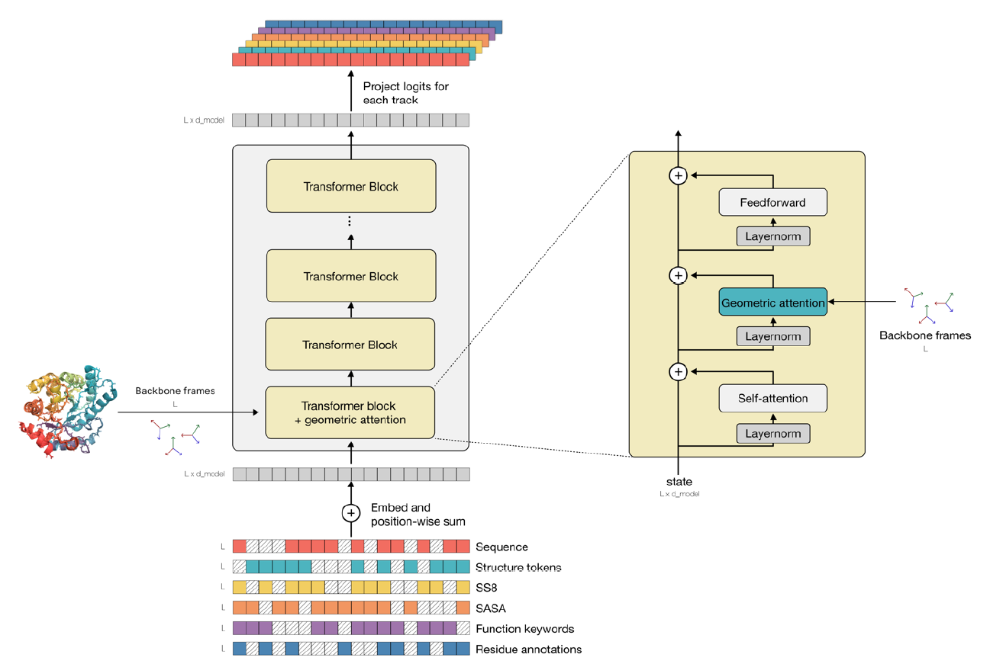
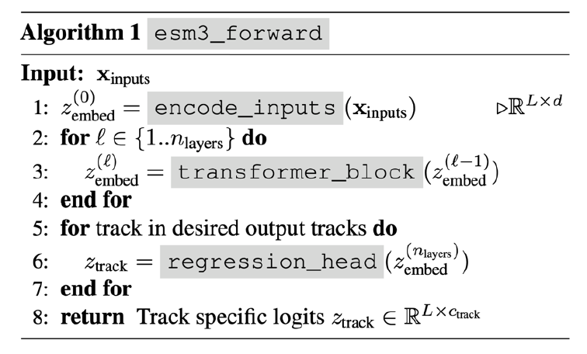
ESM3 architecture
Transformer with some modification:
Input
Geometric attention
Attention mechanism enhanced with 3D spatial information

Slide 5
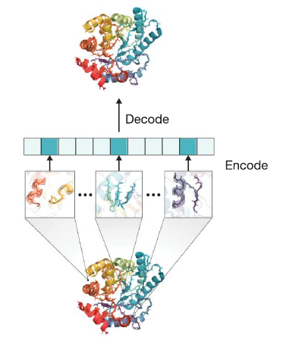
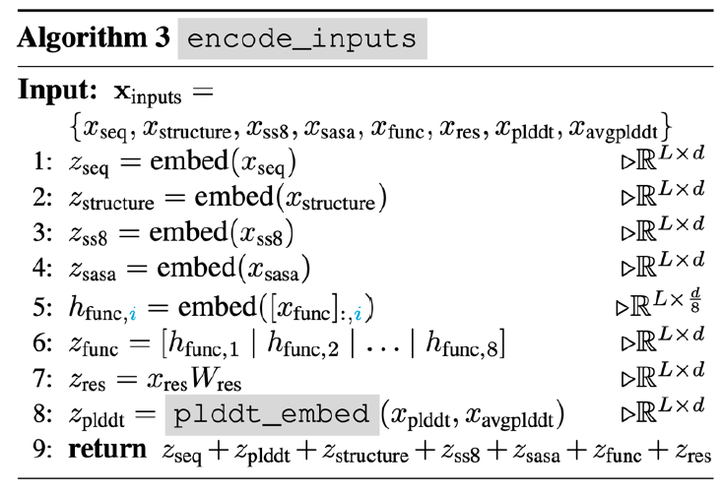

Input tokenization and embedding
Sequence: amino acid [plus special tokens]
Structure: embedding from structure autoencoder
Secondary structure: 8 classes
Quantized solvent-accessible surface area (SASA): discretization into 16 bins
Functional annotation: a bag of keyword from GO and InterPro
Residual annotation: InterPro annotation multi-hot vector

Slide 6
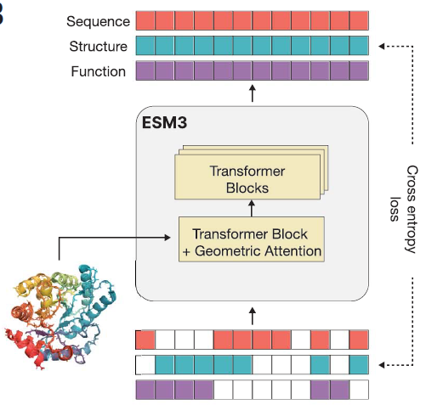
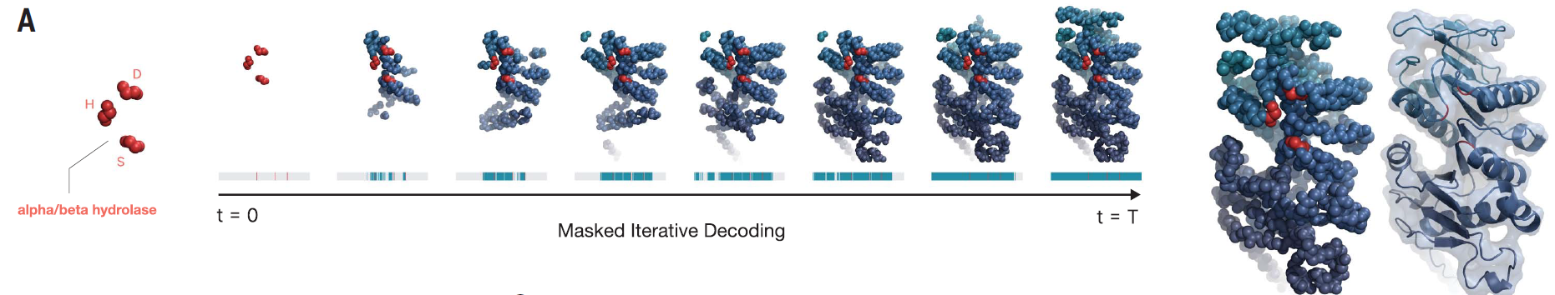
Generative masked modeling
Randomly mask some tokens (tokens replaced by special token [mask]), and train model to predict the masked tokens
Train the model at variable mask rate
High mask rate -> better generative capability
Low mask rate -> better representation learning
Different from LLMs like GPT, which uses autoregressive modeling to predict next token

Slide 7
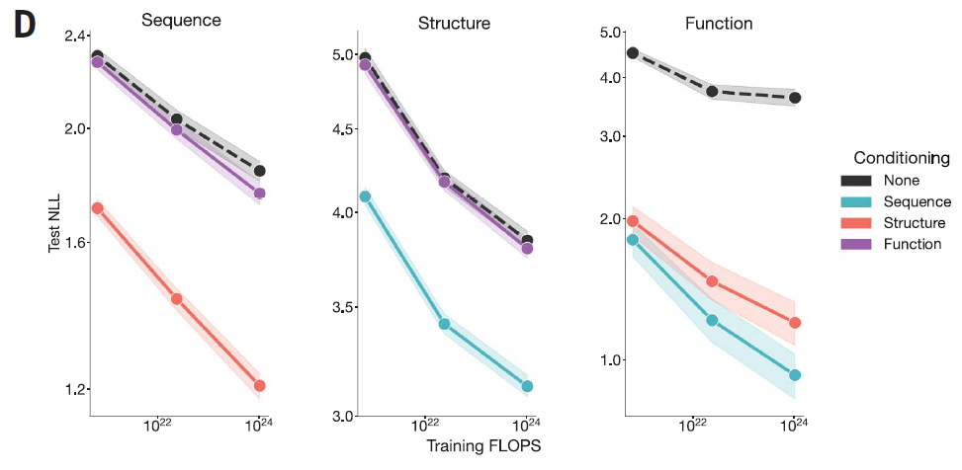
Modeling scale correlated with performance
NLL: negative log-likelihood, loss function, lower is better
Conditioning: given a prompt of sequence/structure/function
Unconditioning: no prompt is given
1.4B
7B
98B

Slide 8
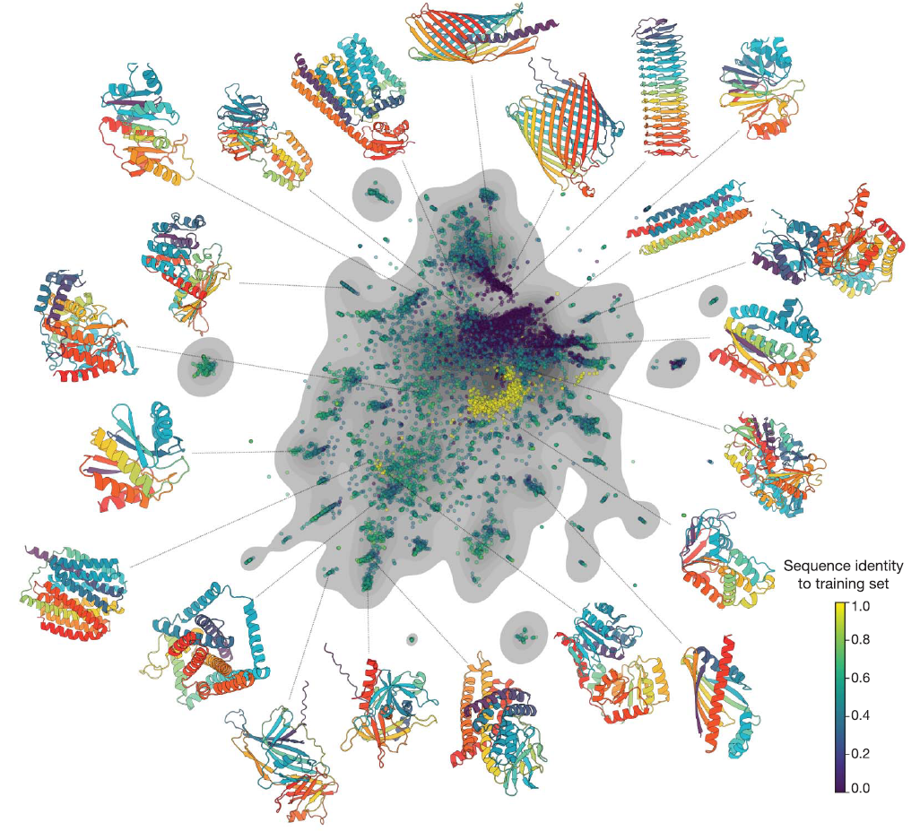
Generation of protein space
A shared multimodal representation space
Examples are real proteins from UniProt

Slide 9
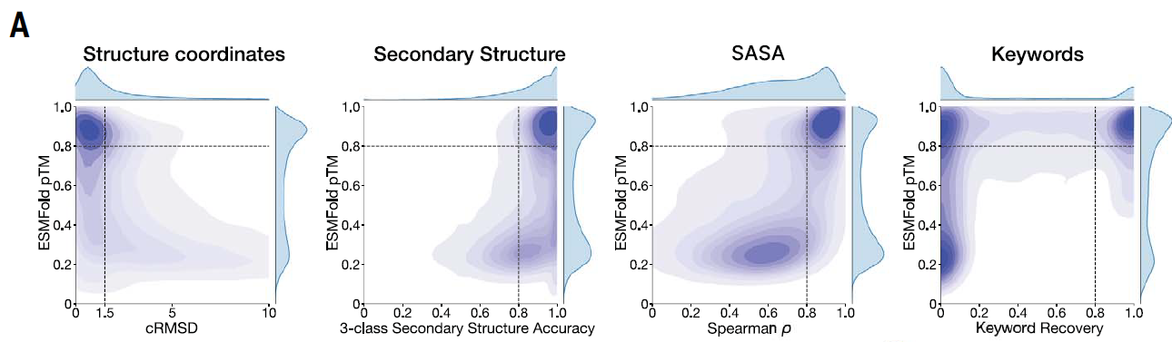
Evaluating generative capability with prompts
Get some prompts from testing protein -> use prompts to generate proteins -> evaluation
Confidence of structure prediction
Distance between actual atoms and prediction

Slide 10
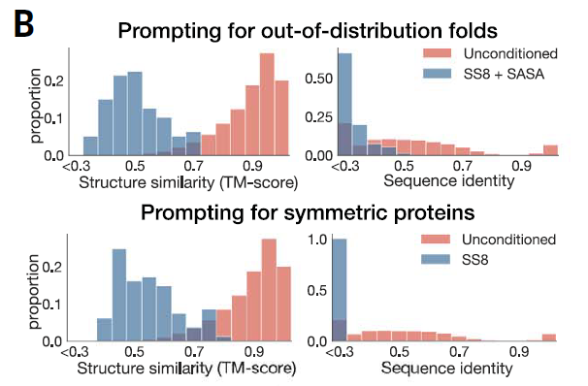
Generation of unnatural proteins
When giving some special prompts, ESM3 can generate special proteins unlike natural proteins
Red: natural protein distribution
Blue: unnatural protein distribution
What proteins are unnatural:
Out-of distribution
Symmetric

Slide 11
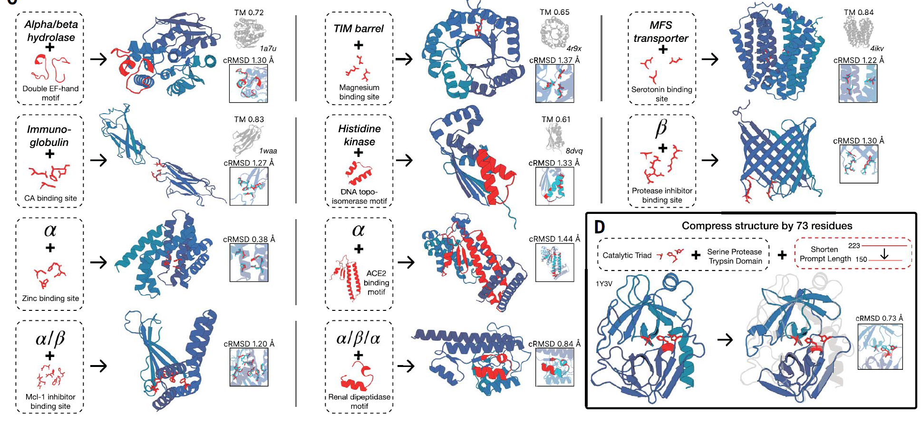
Examples of generation with prompts

Slide 12
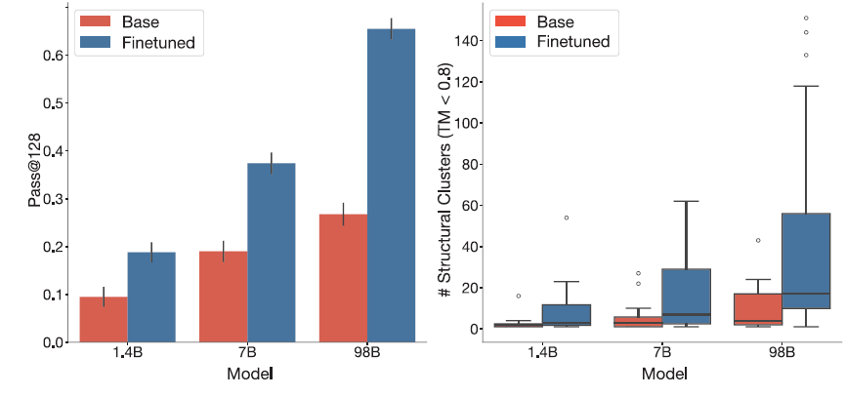
Finetuning models increase ability to solve complex tasks
Finetune (Biological alignment): preference optimization loss to put higher likelihood on high-quality sample relative to low-quality sample
Pass@128: probability of model pass challenging tasks in 128 attempts
Generating a protein that correctly scaffolds a ligand-binding motif
# structural clusters: structure diversity

Slide 13
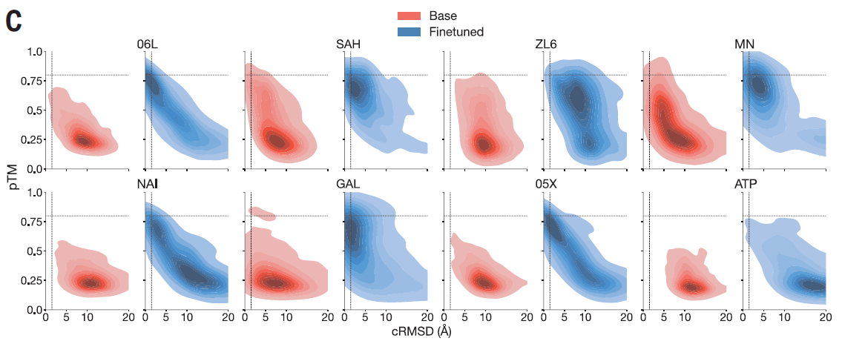
Finetuning models increase ability to solve complex tasks
After finetuning, generated proteins have higher confidence and higher structural similarity to the target protein
Confidence of structure prediction
Distance between actual atoms and prediction

Slide 14
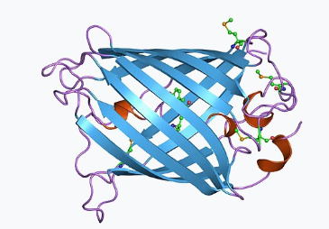
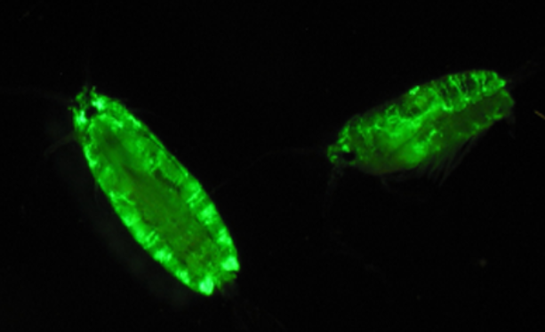
Background: green fluorescent protein (GFP)
A family of proteins with fluorescence
Nobel price 2008
First isolated from jellyfish
Widely used reporter gene in molecular biology

Slide 15
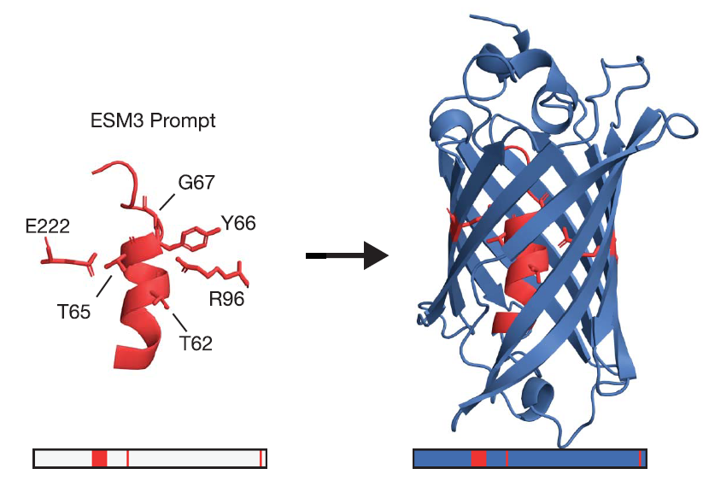
Generating new GFPs using ESM3
Prompting ESM3 with critical residuals for generating chromophore
Chain-of-through:
Initial prompt
Structure
Many rounds, rejecting low-quality ones
Sequence
Final sequence and structure

Slide 16
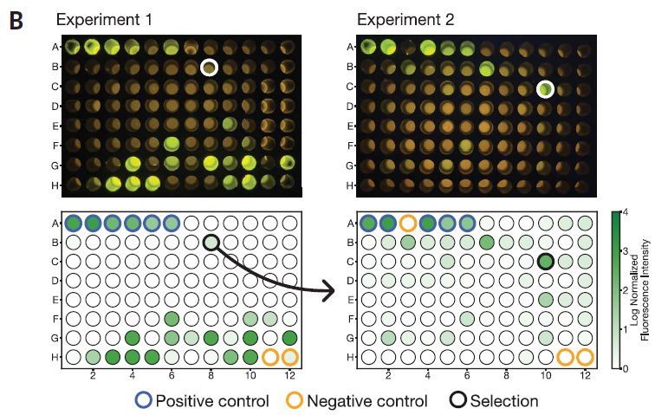
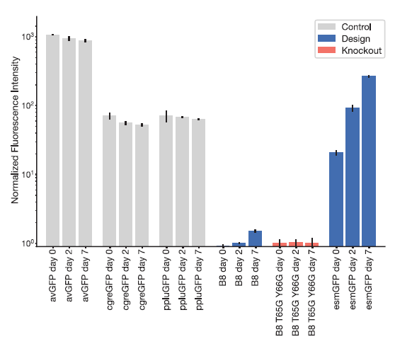
Experimental validation of ESM3-generated GFPs
From 88 designs, some have similar fluorescent level as positive controls
B8 has low sequence identity as natural GFPs
Design more proteins by optimizing B8 -> best one as esmGFP
esmGFP

Slide 17
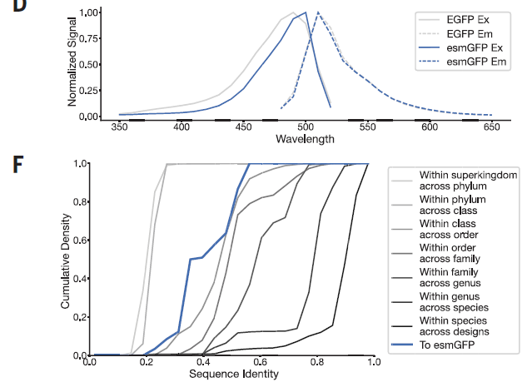
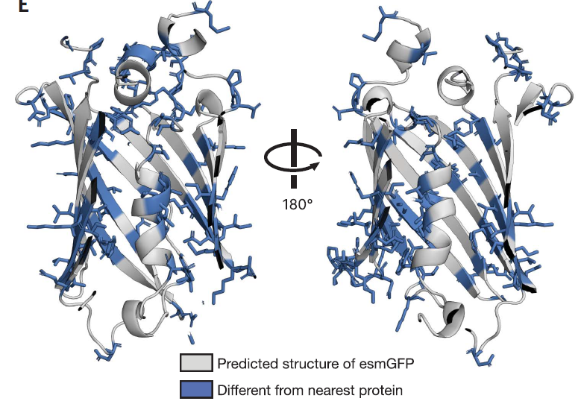
esmGFP is dissimilar from natural proteins
Nearest natural protein from BLAST and MMseqs: tagRFP
Differences in:
Structure
Excitation and emission spectra
Sequence identity
Excitation: absorb light
Emission: emit light
biotaxonomy

Slide 18
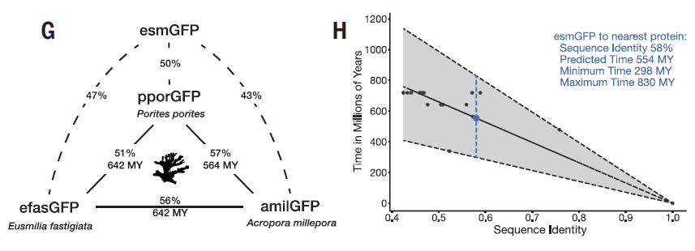
Evolutionary distance by time
Phylogenetics analysis estimate >500 Million years (MY) evolutionary time to last common ancestor
esmGFP and natural anthozon GFPs
Anthozon GFPs

Slide 19
Summary
Introduces ESM3, a frontier-scale multimodal protein language model trained on sequence, structure, and function.
Demonstrates that ESM3 can simulate protein evolution, generate functional proteins far from natural ones, and respond to complex prompts.
Explores whether language models can design proteins as evolution might have over hundreds of millions of years.
Like LLMs, use prompts and chain-of-thought for protein generation

Slide 20
Potential applications
Protein design and engineering
Drug design
Synthetic biology
Bioinformatics modeling of protein sequence, structure or function
Design biocatalysts, biosensors, …

Slide 21
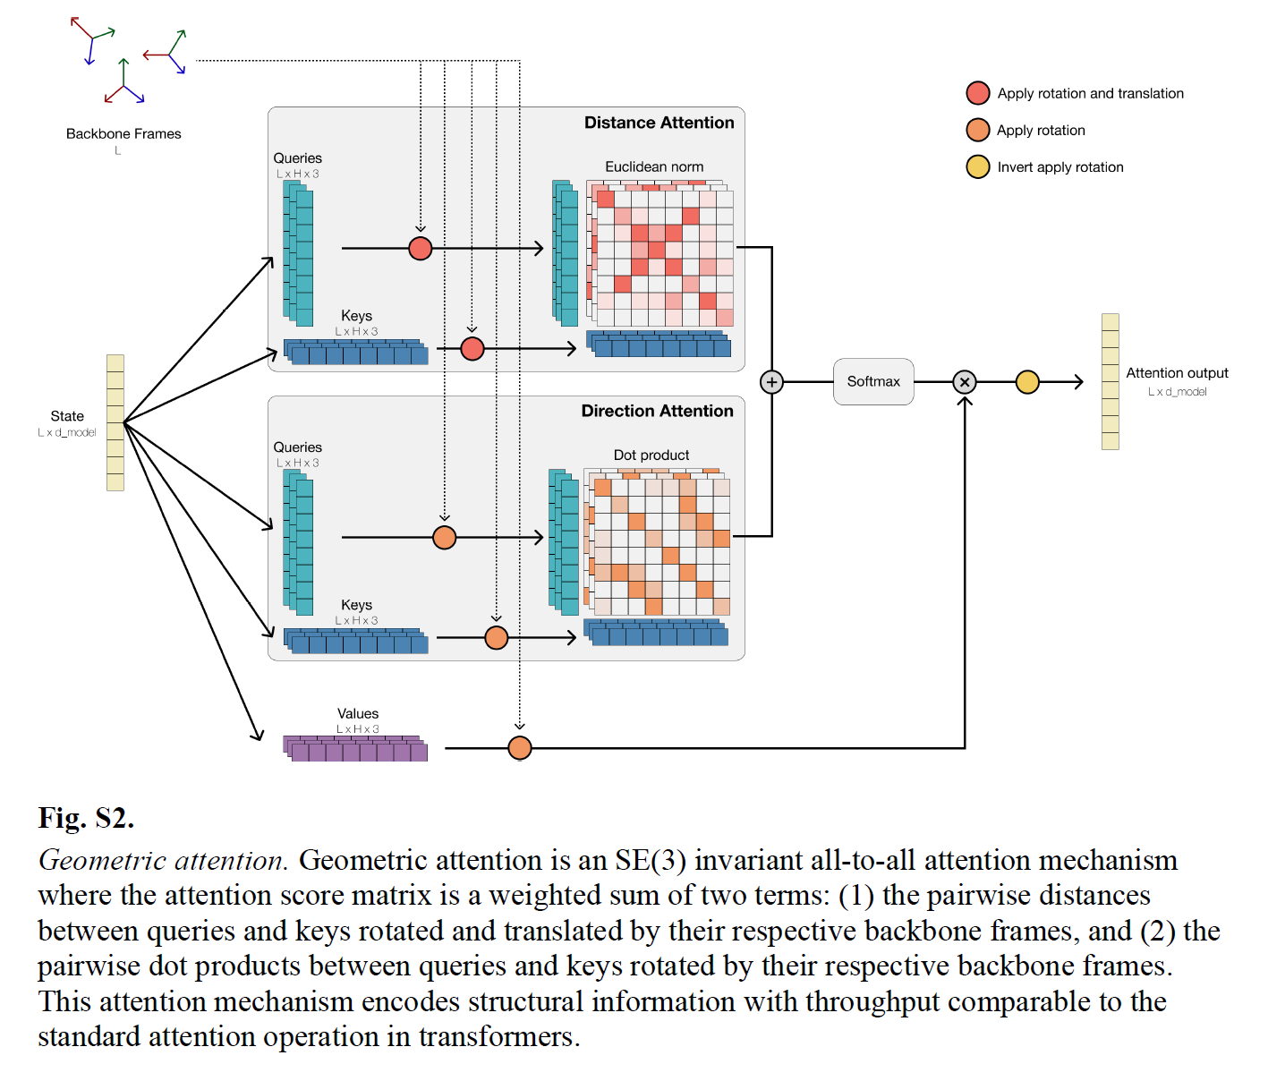
Geometric attention
Attention mechanism enhanced with 3D spatial information
Which residuals are close to a residual in 3D structure?

Slide 22
